Slide 1
Big Data With R
Michael Yan

Slide 2
Introduction and Course Outline
My name is Michael Yan
Day 1
Introduction | 09:30 – 10:30
Break | 10:30 - 10:45
pbdR MPI | 10:45 – 12:00
Lunch | 12:00 – 13:00
pbdR MPI | 13:00 – 14:30
Break | 14:30 – 14:45
pbdR MPI | 14:45 - 16:30
Day 2
Distributed Data | 09:30 – 10:30
Break | 10:30 - 10:45
Distributed Data | 10:45 – 12:00
Lunch | 12:00 – 13:00
Distributed Data | 13:00 – 14:30
Break | 14:30 – 14:45
Data I/O | 14:45 - 16:30
Day 3
Intro to Hadoop and Spark | 09:30 – 10:30
Break | 10:30 - 10:45
Spark in R | 10:45 – 12:00
Lunch | 12:00 – 13:00
Spark in R | 13:00 – 14:30
Break | 14:30 – 14:45
Spark in R | 14:45 - 16:30

Slide 3
An Overview of Parallel Hardware, Software, and Architectures
A Quick Overview of Parallel Hardware
A Quick Overview of Parallel Software
A Cluster Computer Architectures
Batch and Interactive
Summary

Slide 4
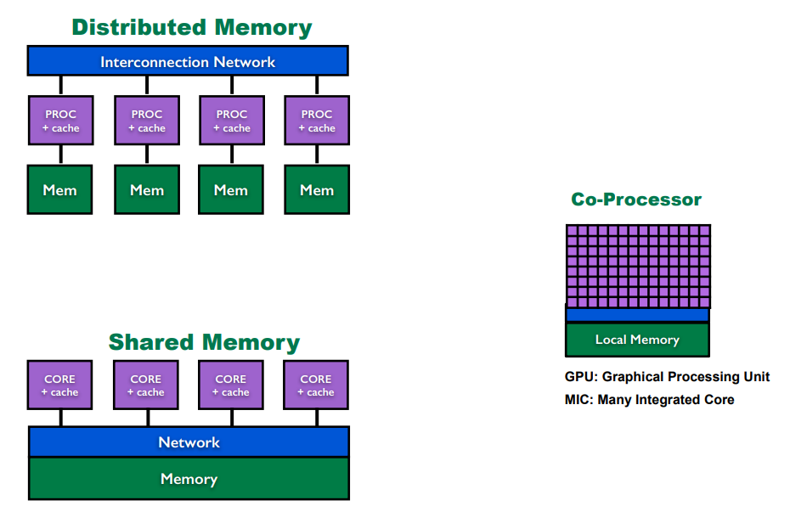
A Quick Overview of Parallel Hardware
Cluster
GPU/Many core
Multicore

Slide 5
A Quick Overview of Parallel Software
Default to be parallel
Sockets
MPI
Hadoop
Offloading tasks
CUDA OpenCL OpenACC OpenMP Pthreads fork
Default to be serial

Slide 6
A Quick Overview of Parallel Software
Default to be parallel
Sockets
MPI
Hadoop
Offloading tasks
CUDA OpenCL OpenACC OpenMP Pthreads fork
Default to be serial

Slide 7
R interface to Low-Level Tools
RHadoop
snow
Rmpi
Parallel
multicore

Slide 8
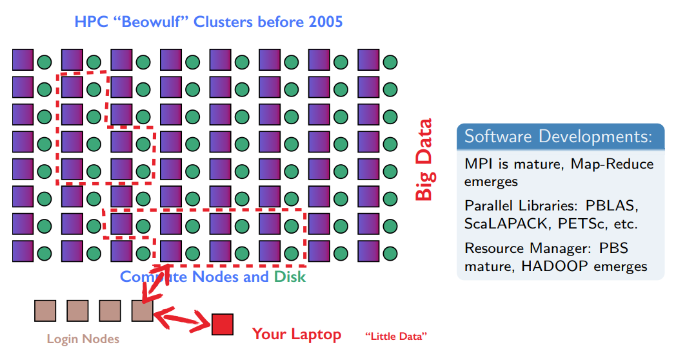
Parallel Computing before Multicore

Slide 9
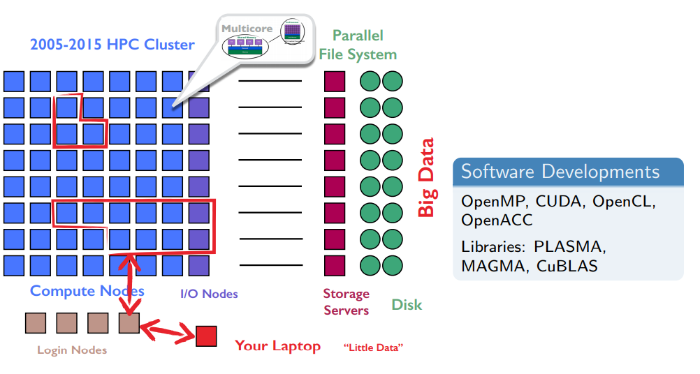
Multicore Emerges and Clusters become Diskless

Slide 10
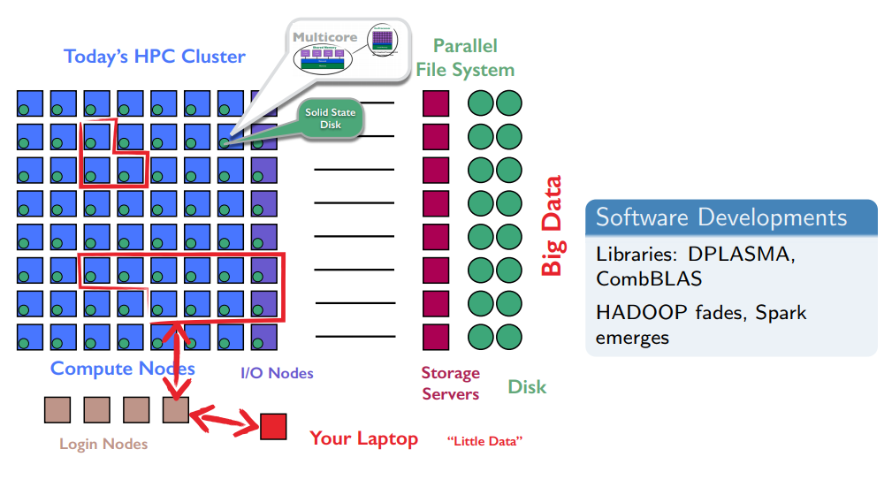
Adding NVRAM to New HPC Systems

Slide 11
R is slow.
Bad programs are slower.
High-level language: one line can touch a lot of data
R will not fix bad programming

Slide 12
Introduction to Parallel Programming Concepts
Implicit parallelism: Parallel details hidden from user
Explicit parallelism: Some assembly required.
Embarrassingly Parallel: Also called loosely coupled. Obvious how to make parallel; lots of independence in computations.
Tightly Coupled: Opposite of embarrassingly parallel; lots of dependence in computations.
Wallclock Time: Time of the clock on the wall from start to finish
Speedup: unitless measure of improvement; more is better.

Slide 13
Parallel Programming Paradigms
Mostly Shared Memory (view from serial)
Manager-Workers (Master-Slaves)
One process hands out work and merges results
Fork-Join
One process splits into many then results are joined

Slide 14
Parallel Programming Paradigms
Mostly Distributed Memory (view from parallel)
Map-Reduce (on a virtual matrix)
Map = Row operations
Reduce = Column operations
Shuffle = Transpose (Hidden from user)
Single Program Multiple Data (SPMD)
Many copies of one program run in parallel
A 30+ year tradition in HPC
Appears harder than it is

Slide 15
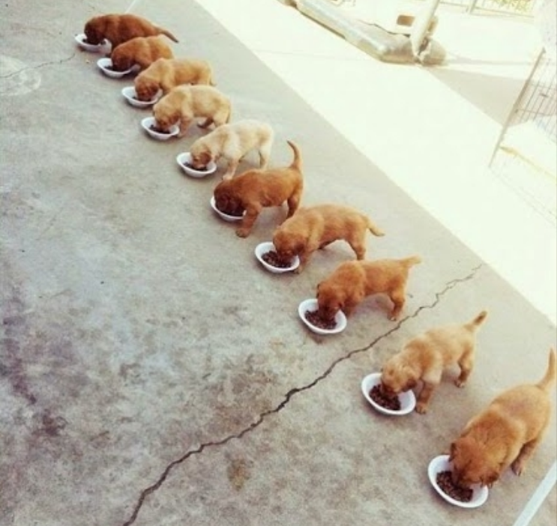
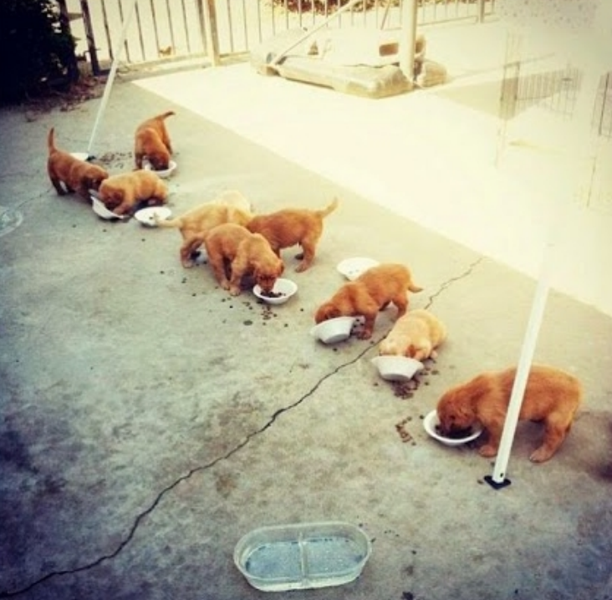
Parallel Programming: Theory vs Practice

Slide 16
Parallel Programming Packages for R
Shared Memory
parallel
foreach
Distributed works in Shared Memory
pbdMPI, pbdDMAT (pbdSLAP and pbdBASE)

Slide 17
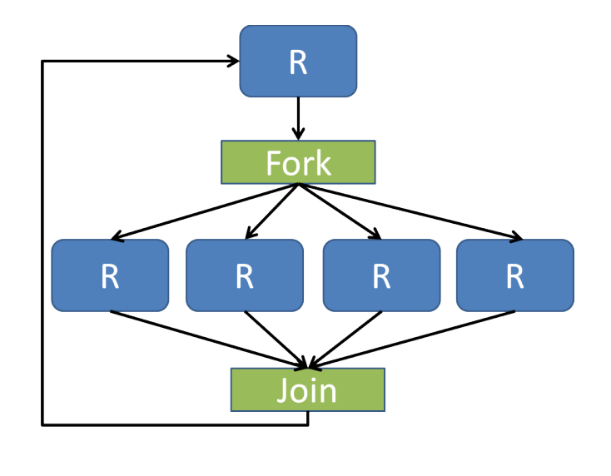
parallel
A simple Fork-Join parallel programming paradigm
Data copied to child on write (handled by OS)
Very efficient.
No Windows support.
Not as efficient as threads (C, C++, FORTRAN).

Slide 18
snow
Uses sockets.
Works on all platforms.
More fiddly than mclapply().
Not as efficient as forks

Slide 19
foreach
On Cran (Revolution Analytics, now MRO).
foreach is a single interface for a number of “backend” packages.
Backends: doMC, doMPI, doParallel, doRedis, doRNG, doSNOW.
A Manager-Workers approach
The Idea: Unify the disparate interfaces.
Works on all platforms (if backend does).
Can even work serial with minor notational change.
Write the code once, use whichever backend you prefer.
Binary operator, non-R-ish synatx.
Overhead issues if you aren’t careful!

Slide 20
Distributed works in Shared Memory
pbdR packages

